Slide 1
INTRODUCTION TO SOCKET PROGRAMMING

Slide 2
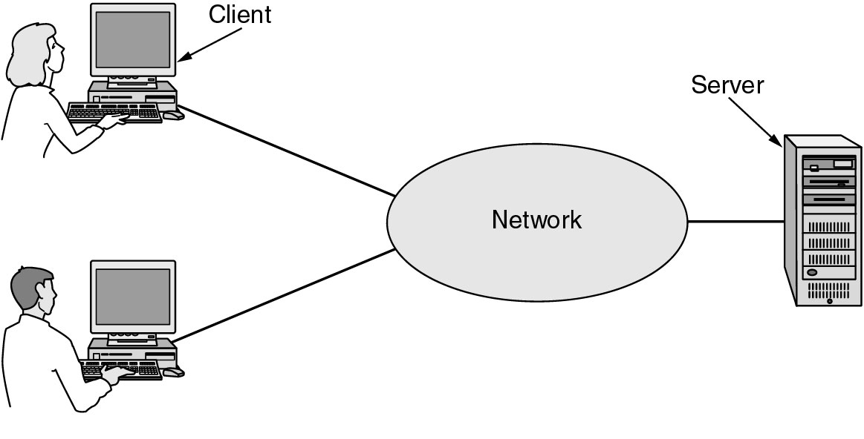
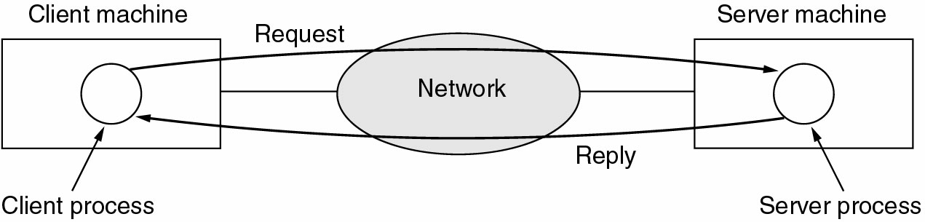
Client Server model
Fig 2: Client Server model
Fig 3: Communication in Client Server model

Slide 3
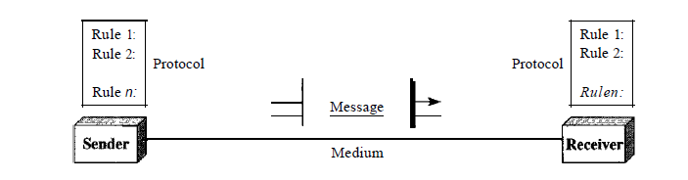
What is Computer Networks?
Computer network is a communication network in which a collection of computers are connected together to facilitate data exchange
The connection between the computers can be wired or wireless.
A computer network basically comprises of 5 components:
Sender
Receiver
Message
Transmission medium
Protocols
Fig 1: Components of data communication

Slide 4

An Analogy

Slide 5
SOCKET Programming in UNIX
Socket Address = IP Address + Port Number
What is “socket”?
A socket is a MECHANISM TO PROVIDE SERVICES to the application program.
Using a socket, two processes can communicate with each other
A socket is bi-directional (full-duplex) transmission
A socket can be created dynamically.(created any time)
In operating systems, a socket is a structure(does not have methods)
A socket address is the combination of an IP address and a port number

Slide 6
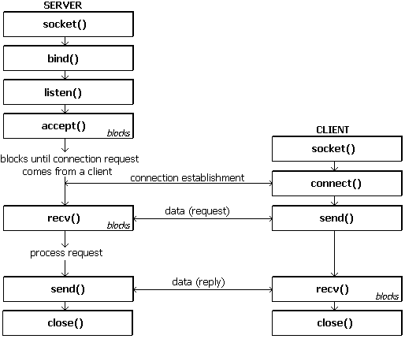
Socket System Calls for Connection-oriented Protocol

Slide 7
Socket System Calls for Connection-less Protocol

Slide 8
The server begins by carrying out a passive open as follows.
(Server when it starts, opens the door for incoming requests but never initiates a service until it is requested to do so. This is called passive open.)
The socket call creates a TCP socket.
The bind call then binds the well-known port number of the server to the socket.
The listen call turns the socket into a listening socket that can accept incoming connections from clients.
The accept call puts the server process to sleep until the arrival of a client connection.

Slide 9
Elementary Socket System Calls

Slide 10
The client does an active open(A client opens the communications channel using the IP address of the remote host and the well-known port address of the specific server program running on that machine).
The socket call creates a socket on the client side, and the connect call establishes the TCP connection to the server with the specified destination socket address.
The accept function at the server wakes up and returns the descriptor for the given connection namely, the source IP address, source port number, destination IP address, and destination port number.
The client and server are now ready to exchange information.

Slide 11
Socket facilities are provided to programmers through system calls except that control is transferred to the OS kernel once the call is invoked.
To use these facilities, the header files<sys/types.h> and <sys/socket.h>
Before an application program can transfer any data it must first create an endpoint for communication by calling socket

Slide 12
“socket” System Call Definition and Parameters
To do network I/O, the first thing a process must do is create a socket by calling the socket system call, specifying the type of communication protocol desired (TCP, UDP etc.) as follows
int socket(int family, int type, int protocol);
This system call returns an integer which is (similar to file descriptor) a reference to the socket called the socket descriptor. On error, -1 is returned.

Slide 13
Berkeley Sockets
socklen_t and size_t are same as int
u_long and uint32_t are same as long int
u_short and uint16_t are same as short

Slide 14
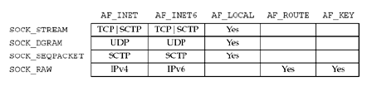
SOCK_RAW – provides access to internal network interfaces and is available only to super-user.
SOCK_SEQPACKET – Provides a sequenced, reliable, two-way connection-based data transmission path for datagrams of fixed maximum length

Slide 15
Since we are interested in internet protocols the family parameter is set to AF_INET.
The type field takes the values SOCK_STREAM which means a stream socket is created (used in the case of TCP) and SOCK_DGRAM which means a datagram socket is created (used in the case of UDP).
The protocol argument to the socket system call is typically set to 0 to indicate default protocol.
The default protocol for SOCK_STREAM with AF_INET family is TCP.
Example
if ( (sd = socket( AF_INET, SOCK_STREAM, 0 )) < 0 ) {
cout<<“Socket creation error”;
exit(-1);
}

Slide 16
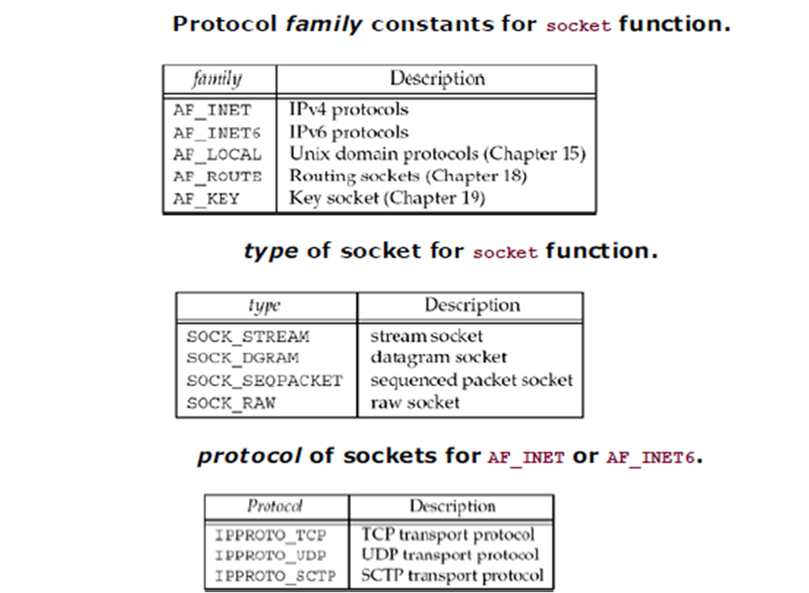

Slide 17
“bind” System Call Why use bind?
Bind helps the servers to register themselves with the system. It tells the system that “any messages received at the particular IP address and the specified port be directed to me”.
This is required in case of both connection-oriented (like TCP) and connectionless (like UDP) servers.
A connectionless client needs to assure that the system assigns it some unique address, so that the other end (the server) has a valid return address to send its responses to. This is not required in the case of connection-oriented client.

Slide 18
“bind” System Call Definition and Parameters
This system call assigns a name to an unnamed socket –
int bind(int sockfd, struct sockaddr *myaddr, socklen_t addrlen);
The sockfd argument is nothing but the socket descriptor which is obtained after executing the socket system call.
The second argument is a pointer to a protocol-specific address and the third argument is the size of the address structure passed as reference in the second argument.
Since we are interested in Internet Protocols the second argument passed is of type sockaddr_in.

Slide 19
“bind” System Call Definition and Parameters
This system call assigns a name to an unnamed socket –
int bind(int sockfd, struct sockaddr *myaddr, socklen_t addrlen);
The sockfd argument is nothing but the socket descriptor which is obtained after executing the socket system call.
The second argument is a pointer to a protocol-specific address and the third argument is the size of the address structure passed as reference in the second argument.
Since we are interested in Internet Protocols the second argument passed is of type sockaddr_in.

Slide 20
“bind” System Call The sockaddr_in structure
The structure sockaddr_in (defined in <netinet/in.h>) is as follows –
struct in_addr {
u_long s_addr;
};
struct sockaddr_in {
short sin_family;
u_short sin_port;
struct in_addr sin_addr;
char sin_zero[8]; /* unused */
};
struct sockaddr {
unsigned short sa_family;
char sa_data[14];
};

Slide 21
“bind” System Call More on sockaddr_in structure…
The sin_family field takes the value AF_INET indicating that an internet family protocol is being used.
The sin_port field identifies the server/client application to the host where it is running.
The sin_addr structure has only one field s_addr which identifies the server side IP address (32-bits) to which various clients can connect.
The sin_port and sin_addr fields are network byte ordered i.e., a format that is permissible for a given network protocol.

Slide 22
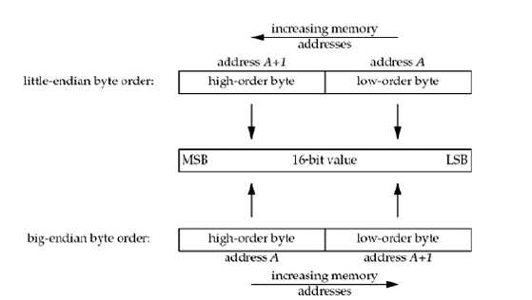
Consider a 16-bit integer that is made up of 2 bytes. There are two ways to store the two bytes in memory: with the low-order byte at the starting address, known as little-endian byte order, or with the high-order byte at the starting address, known as big-endian byte order.
So that machines with different byte order conventions can communicate, the Internet protocols specify a canonical byte order convention for data transmitted over the network. This is known as network byte order or big endian byte order.

Slide 23
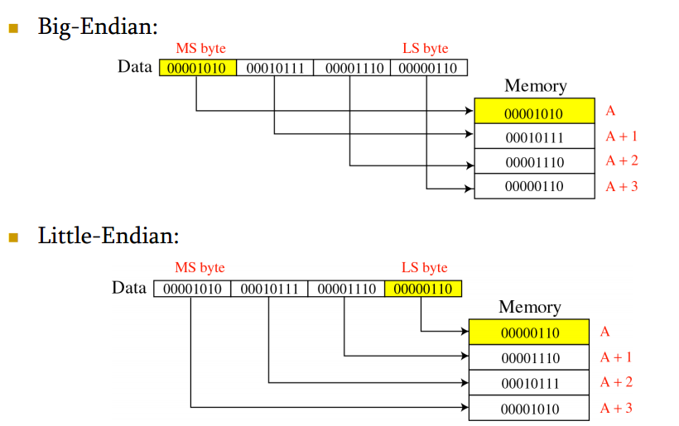
BIG-ENDIAN BYTE ORDER IS ALSO REFERRED TO AS NETWORK BYTE ORDER
LITTLE-ENDIAN BYTE ORDER IS ALSO REFERRED TO AS HOST BYTE ORDER

Slide 24
“bind” System Call Byte ordering routines
The various byte ordering routines that provide the necessary conversion from host byte ordering to network byte ordering and vice versa are as follows –
uint32_t htonl(uint32_t hostlong);
uint16_t htons(uint16_t hostshort);
uint32_t ntohl(uint32_t netlong);
uint16_t ntohs(uint16_t netshort);
htonl and ntohl convert from host-to-network and network-to-host byte order respectively and return a long integer value representing the converted ordering.

Slide 25
“bind” System Call More on byte ordering routines…
htons and ntohs convert from host-to-network and network-to-host byte order respectively and return a short integer value representing the converted ordering.
htonl and ntohl can be used while converting network IP addresses which are passed to sin_addr.s_addr field of the sockaddr_in structure.
htons and ntohs can be used while converting the 16-bit port number that is passed to the sin_port field of the sockaddr_in structure.

Slide 26
“bind” System Call Address conversion routines
An internet address is usually written in dotted-decimal notation i.e., in the form of A.B.C.D. Thus it is necessary that this address be converted into proper format before passing the value to the sin_addr.s_addr field of the sockaddr_in structure.
The following functions provide the necessary address conversion –
in_addr_t inet_addr(const char *cp);
char *inet_ntoa(struct in_addr in);
The inet_addr function converts the dotted-decimal address string into binary data in network byte order.

Slide 27
“bind” System Call More on address conversion routines…
If the input provided to inet_addr is invalid an error occurs, which makes the function returns an address value where all the 32 bits are set to 1, which means 255.255.255.255 is returned if an error occurs.
Thus for the inet_addr function 255.255.255.255 is considered to be an error, but nevertheless it is a valid network (reserved) address. Thus the inet_addr function fails in this regard. (A solution to this discussed shortly).
The inet_ntoa function does the reverse conversion i.e., it extracts the 32-bit internet address and converts it into the usual dotted-decimal notation in host byte order.

Slide 28
“bind” System Call More on address conversion routines…
The inet_addr function is an obsolete interface to inet_aton which provides a clearer way to indicate errors. The function prototype is as follows –
int inet_aton(const char *cp, struct in_addr *inp);
inet_aton converts the internet host address cp from the usual dotted-decimal notation into binary data and stores the converted address in the structure pointed to by inp.
inet_aton returns a non-zero value if the address provided is valid or else zero is returned, thus solving the problem posed by inet_addr. Thus it is advised that inet_aton be used instead of inet_addr.

Slide 29
“bind” System Call Some more information…
Since the second argument to the bind system call is of type pointer to sockaddr structure, but the network specific address structure sockaddr_in is used, this (sockaddr_in) structure has to be type-casted before passing its address to bind. Even though no errors are raised (a warning will be given though) the call fails.
On success, 0 is returned. On error, -1 is returned by the bind system call.

Slide 30
“listen” System Call Definition and Parameters
This system call is used by a connection-oriented server (i.e., SOCK_STREAM socket) to indicate that it is willing to receive connections from clients.
The function prototype is as follows –
int listen(int sockfd, int backlog);
The sockfd field is nothing but the socket descriptor obtained after executing the socket system call.
The backlog parameter defines the maximum length of the queue of pending connections may grow to. This argument is usually specified as 5 which the maximum value currently allowed.

Slide 31
“accept” System Call Definition and Parameters
The accept system call extracts the first connection request on the queue of pending connections and creates a new connected socket with mostly the same properties as that of sockfd. This newly created socket’s descriptor is returned and only this descriptor must be used for further communication with the intended client. The original socket descriptor sockfd remains unaffected by this call.
The function prototype is as follows –
int accept(int sockfd, struct sockaddr *peer, socklen_t *addrlen);

Slide 32
“accept” System Call sockfd, peer and addrlen parameters…
The sockfd parameter is the socket descriptor that was created with socket, bound to a local address with bind and is listening for connections after listen.
The argument peer is a pointer to a sockaddr structure. This structure will be filled in with the address of the peer entity (connecting entity or client). Since the sockaddr_in structure is used (in the case of internet family protocols) the structure passed as the second argument to accept must be adequately type-casted.
The addrlen is a value-result parameter whose value is initially set to contain the size of the structure pointed to by peer.

Slide 33
“accept” System Call Parameters and more…
On return the value in the addrlen parameter is updated so as to contain the actual length (in bytes) of the address returned.
accept system call blocks the caller until a connection from a client is established.
As mentioned earlier accept returns a non-negative integer that represents the descriptor for the accepted socket while listen returns 0 on success.
Both listen and accept system calls return -1 if any error occurs.

Slide 34
“connect” System Call Definition and Parameters
A client process can establish a connection with a server using the connect system call as follows –
int connect(int sockfd, const struct sockaddr *servaddr, socklen_t addrlen);
The sockfd parameter is the socket descriptor that is returned by the socket system call (at the client side).
The servaddr parameter is the address of the server (IP address and port number of the server) to which the client wishes to connect.
addrlen is the length of the address structure pointed to by servaddr.

Slide 35
“connect” System Call connection-oriented vs. connectionless…
For connection-oriented protocols the connect system call results in the actual establishment of a connection between the client and the server.
Specific parameters such as buffer size, amount of data to exchange between acknowledgements etc. might be agreed upon in the process of establishing the connection.
A connectionless client can also use the connect system call. But here an actual establishment of connection between the server and client does not take place.
In the case of a connectionless client, the servaddr is stored by the process in the local system so that all future data is directed to the address specified by servaddr.

Slide 36
“connect” System Call connection-oriented vs. connectionless…
And the client socket will receive only datagrams from the address specified by servaddr (in the case of a connectionless client).
Thus if the connectionless client wishes to receive datagrams from another host then the only thing that needs to be done is change the address in the servaddr address structure and use connect again.
The advantage of using connect with a connectionless client is that every time a datagram needs to be sent, the destination address need not be specified again and again (specially if there is large amount of data to be exchanged).

Slide 37
“connect” System Call Some more information…
If the connection or binding succeeds, 0 is returned. On error, -1 is returned.
Note that all the system calls discussed so far under Berkeley Sockets can be used by including the following headers –
<sys/types.h>
<sys/socket.h>
To use the system calls send, sendto, recv and recvfrom (discussed next) the above mentioned header files must be included in the socket program.

Slide 38
“send” System Call Definition and Parameters
A connection-oriented client/server can use the send system call to exchange messages between each other. The function prototype is as follows –
int send(int sockfd, const void *msg, size_t len, int flags);
sockfd is the socket descriptor returned by the socket system call in the case of the client and the new socket descriptor returned by the accept system call in the case of the server.
msg is pointer to the message that has to be read or written and len is the number of bytes has to be read or written .
The flags parameter is usually set to 0.

Slide 39
“recv” System Call Definition and Parameters
To receive messages from a connected socket a client/server can use the recv system call as follows –
int recv(int sockfd, void *buf, size_t len, int flags);
sockfd and flags have the same meaning as in the send system call.
Here buf is nothing but the message that will be received by the client/server.
The len parameter specifies the number of characters (in bytes) that can be read at once.
The recv system call blocks until a message is received.

Slide 40
“close” System Call Definition and Parameters
The Unix close system call is also used to close a socket.
The function prototype is as follows –
int close(int fd);
Here fd refers to the socket descriptor.
The close system call does not close the socket at once. Before closing it tries to send any queued data or any queued data to be sent is flushed.
The close system call returns 0 on success and -1 on error.

Slide 41
sendto()--UDP Sockets
int sendto(int socket, char *buffer, int length, int flags, struct sockaddr *destination_address, int address_size);
For example:
struct sockaddr_in sin;
sin.sin_family = AF_INET;
sin.sin_port = htons(12345);
sin.sin_addr.s_addr = inet_addr("128.227.22.43");
char *msg = "Hello, World";
sendto(s, msg, strlen(msg)+1, 0, (struct sockaddr *)sin, sizeof(sin));
Notes:
Once a UDP socket has been created and bound to a local source port, it is now capable of being used for sending and receiving datagrams. The functions for sending and receiving datagrams are sendto and recvfom. Sendto has the following prototype:
int sendto(int socket, char *buffer, int length, int
flags, struct sockaddr *destination_address, int
address_size);
Where socket is a UDP socket that has been created and bound to a source port. buffer is a pointer to an array of bytes that are to be sent over the network. The length field specifies how long this array is. The flags field is normally 0.
In the above example, s is assumed to be a created UDP socket that has already bound to a local port. When sendto is called, a UDP datagram is sent to the host at 128.227.22.43. It's assumed there is a process with a socket bound to port 12345 waiting on a recvfrom call to receive the contents of the message being sent. The sendto function returns the number of bytes sent, or -1 if an error occurred. With UDP sockets, it's not usually necessary to check to see how many bytes were sent because this information is specified in the length field.

Slide 42
recvfrom()--UDP Sockets
Int recvfrom(int socket, char *buffer, int length, int flags, struct sockaddr *sender_address, int *address_size)
For example:
struct sockaddr_in sin;
char msg[10000];
int ret;
int sin_length;
sin_length = sizeof(sin);
ret = recvfrom(s, msg, 10000, 0, (struct sockaddr *)sin, &sin_length);
printf("%d bytes received from %s (port %d)\n", ret, inet_ntoa(sin.sin_addr), sin.sin_port);
Notes:
Recvfrom is similar to sendto. Buffer is a pointer to a byte array that is to be filled with the contents of the datagram. The length argument specifies the maximum length to copy into buffer. This is to prevent buffer over-run errors in case the datagram is larger than expected. The flags field is normally 0. The sender_address argument is a pointer to a socket address structure that gets filled with a copy of the sender's IP address and source port. The address_size parameter must be initialized to the size of the sockaddr structure being used. On return it will hold the number of bytes that were copied into the sender_address structure.
Recvfrom returns the number of bytes copied into the byte array pointed to by buffer. If the buffer space specified in length is less than that of the original datagram, only length bytes will be copied into buffer, and the rest will be lost.
In the above example, recvfrom will wait until it receives a datagram on the local port associated with the socket s. The printf statement will list information regarding the size, source IP address, and source port of the datagram received.
For any open socket that has been successfully binded to a port, the application may call sendto and recvfrom using that socket as many times as it needs to.
Fragmentation is completely transparent to the applications that are sending and receiving datagrams.

Slide 43
A Simple TCP server program
#include<iostream.h>
#include<stdio.h>
#include<stdlib.h>
#include<string.h>
#include<unistd.h>
#include<sys/socket.h>
#include<sys/types.h>
#include<netinet/in.h>
#define MAXSIZE 50

Slide 44
main()
{
int sockfd,newsockfd,retval;
socklen_t actuallen;
int recedbytes,sentbytes;
struct sockaddr_in serveraddr,clientaddr;
char buff[MAXSIZE];
int a=0;
sockfd=socket(AF_INET,SOCK_STREAM,0);
if(sockfd==-1) {
cout<<"\nSocket creation error";
exit(-1); }

Slide 45
newsockfd=accept(sockfd,(struct sockaddr*)&clientaddr,&actuallen);
if(newsockfd==-1) {
close(sockfd);
exit(0); }
recedbytes=recv(newsockfd,buff,sizeof(buff),0);
if(recedbytes==-1) {
close(sockfd);
close(newsockfd);
exit(0); }
puts(buff);
cout<<"\n";

Slide 46
serveraddr.sin_family=AF_INET;
serveraddr.sin_port=htons(3387);
serveraddr.sin_addr.s_addr=htonl(INADDR_ANY);
/*With IPv4, the wildcard address is specified by the constant INADDR_ANY, whose value is normally 0. This tells the kernel to choose the IP address.*/
retval=bind(sockfd,(struct sockaddr*)&serveraddr,sizeof(serveraddr));
if(retval==-1) {
cout<<"Binding error"; close(sockfd);
exit(0); }
retval=listen(sockfd,1);
if(retval==-1) { close(sockfd);
exit(0); }
actuallen=sizeof(clientaddr);

Slide 47
gets(buff);
sentbytes=send(newsockfd,buff,sizeof(buff),0);
if(sentbytes==-1) {
close(sockfd);
close(newsockfd);
exit(0);
}
close(newsockfd);
close(sockfd);
}

Slide 48
Header | Functions defined
arpa/inet.h | inet functions: inet_aton, inet_ntoa, and inet_addr
unistd.h | System call: close, fork, exec
sys/socket.h | basic socket definitions recv, send
sys/types.h | basic system data types
netinet/in.h | sockaddr_in{} and other Internet definitions
sys/stat.h | for S_xxx file mode constants
fcntl.h | for nonblocking

Slide 49
